Slide 1
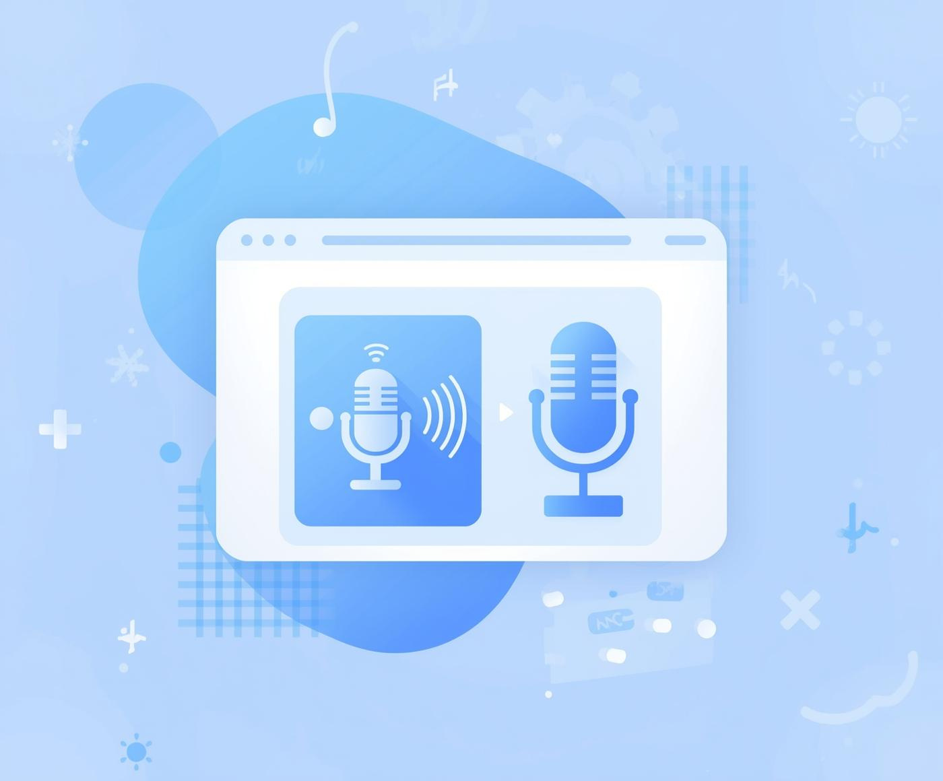
Voice-to-Text Converter
Jenil A Patadiya
From:-ITM SLS Baroda University
Enrollment:-24C15043

Slide 2

Project Functionality
How the Voice-to-Text Converter Works and Its Key Features
The Voice-to-Text Converter utilizes the powerful Web Speech API to transform spoken words into accurate text. Built with simple HTML, CSS, and JavaScript, it offers a responsive and user-friendly interface. This project demonstrates the seamless integration of voice input, enhancing accessibility and convenience for users.

Slide 3
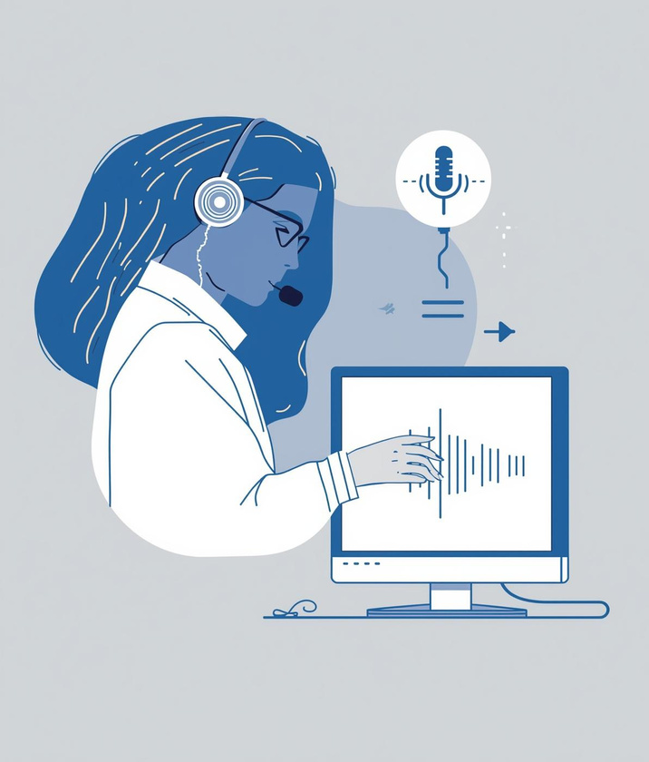



Project uses and scope
Hands-free
Accessibility
Productivity
Note-taking
Simplifies tasks without needing manual input
Enhances usability for individuals with disabilities
Increases efficiency by minimizing typing time.
Facilitates efficient information capture on-the-go

Slide 4
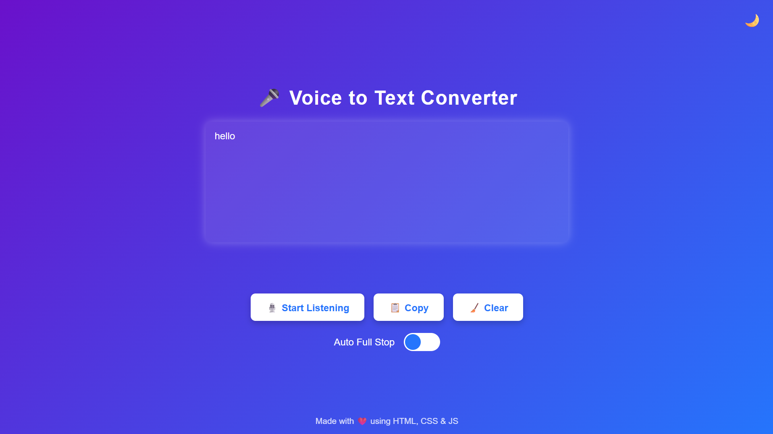
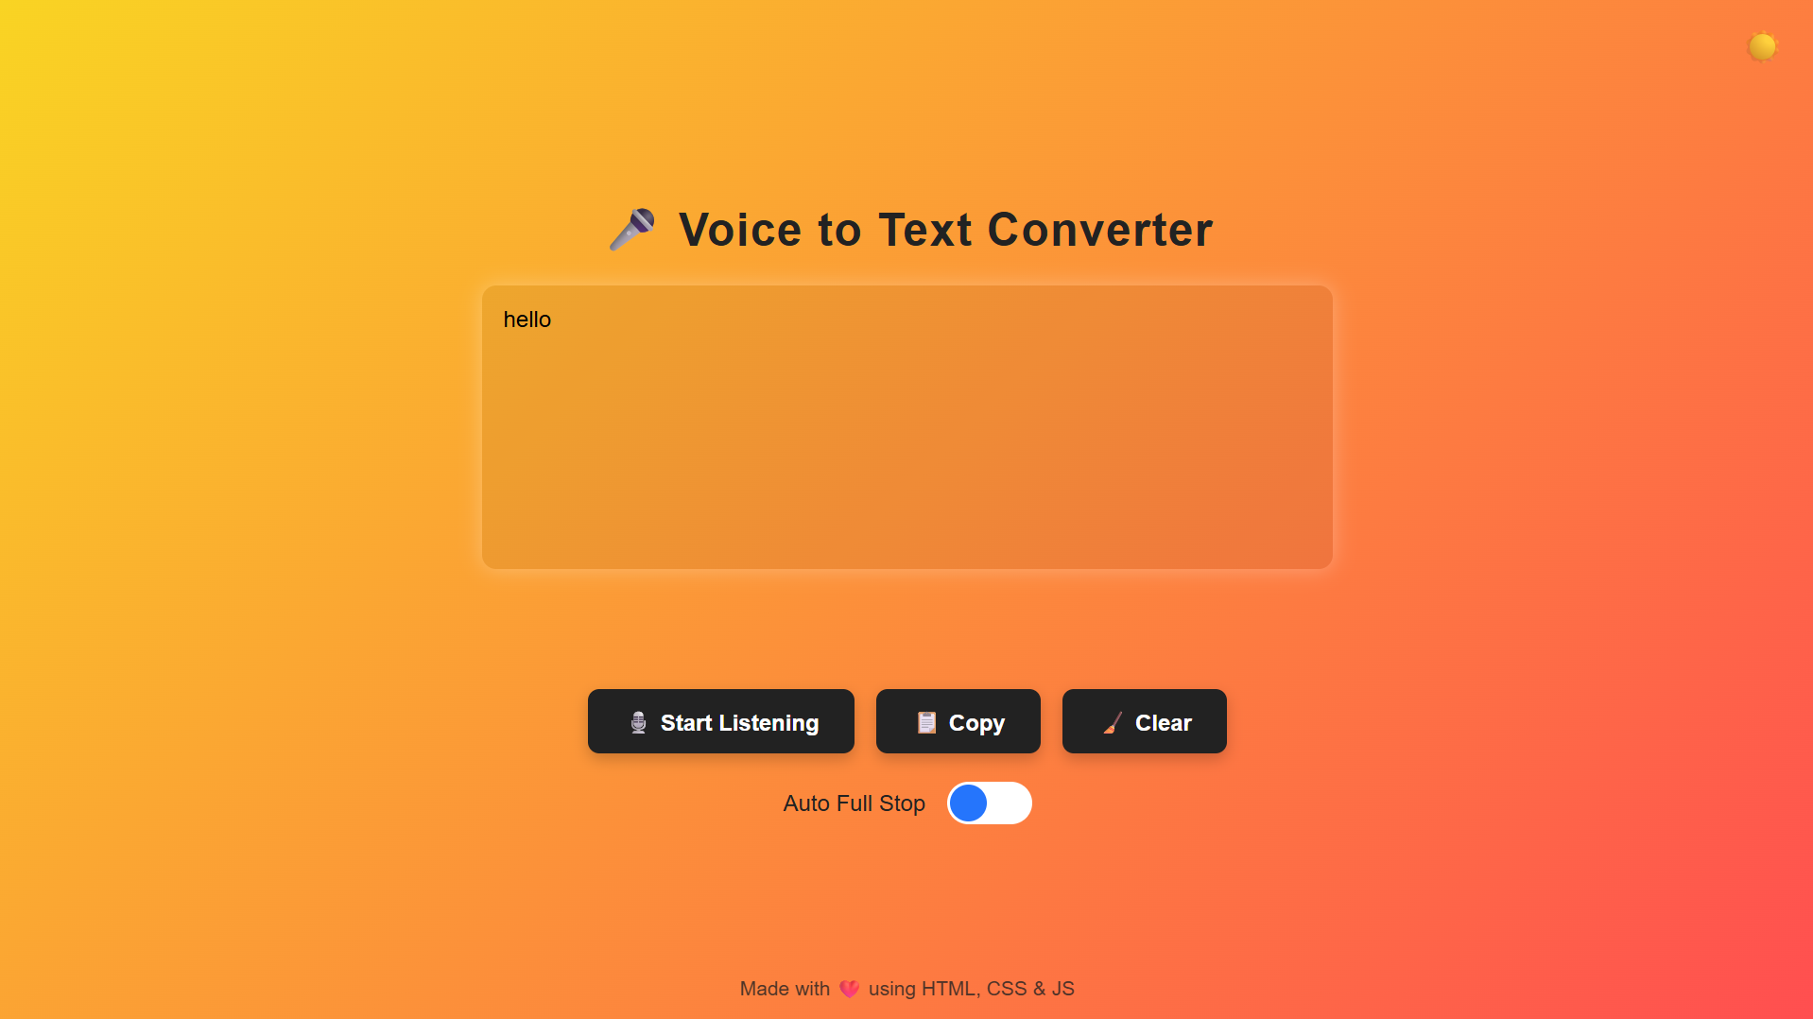
NOVEMBER 2025
Voice-to-Text Converter
Accurate Voice Input
Thank You

